Slide 1

Chapter 1
Introduction
Objectives
Upon completion you will be able to:
Understand how the Internet came into being
Understand the meaning of the terms protocol and standard
Understand the various organizations involved in the standards
Understand the different levels of Internet service providers
Understand the groups involved in Internet administration

Slide 2
1.1 A Brief History
A network is a group of connected, communicating devices. An internet is two or more networks that can communicate with each other. The most notable internet is called the Internet. Millions of people are users. Yet this extraordinary communication system only came into being in 1969.
The topics discussed in this section include:
ARPANET
Birth of the Internet
Transmission Control Protocol / Internetworking Protocol
MILNET
CSNET, NSFNET & ANSNET
The Internet Today
Time Line
Growth of the Internet

Slide 3
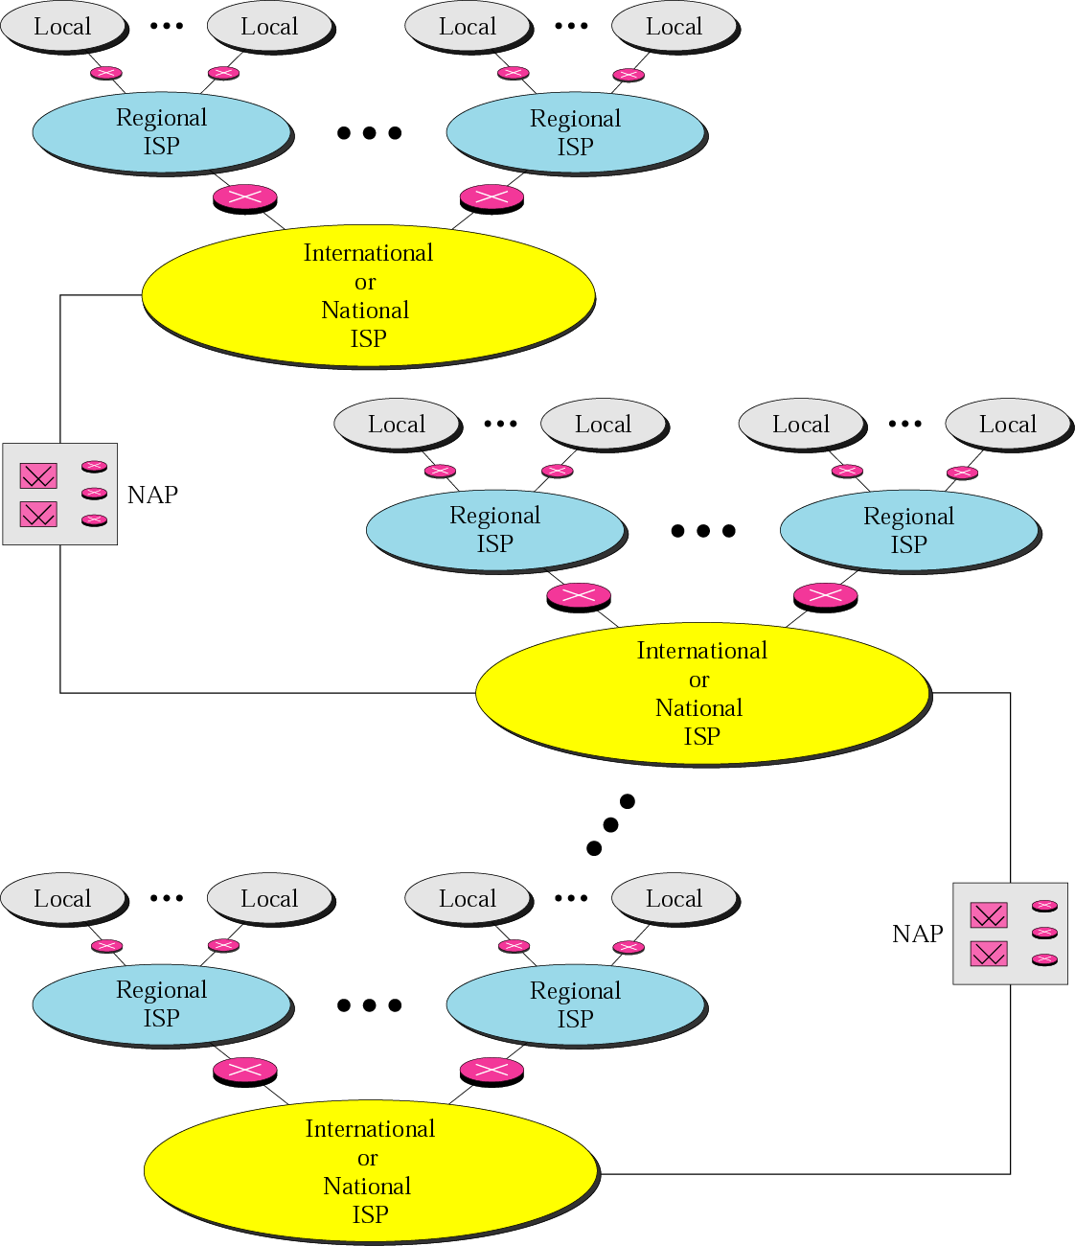
Figure 1.1 Internet today

Slide 4
1.2 Protocols and Standards
In this section, we define two widely used terms: protocols and standards. First, we define protocol, which is synonymous with “rule.” Then we discuss standards, which are agreed-upon rules.
The topics discussed in this section include:
Protocols
Standards

Slide 5
1.3 Standards Organizations
Standards are developed through the cooperation of standards creation committees, forums, and government regulatory agencies.
The topics discussed in this section include:
Standards Creation Committees
Forums
Regulatory Agencies

Slide 6

Note:
The websites for the standardization organizations are given in Appendix F.

Slide 7
1.4 Internet Standards
An Internet standard is a thoroughly tested specification. There is a strict procedure by which a specification attains Internet standard status. A specification begins as an Internet draft, working document with no official status and a six-month lifetime. A draft may be published as a Request for Comment (RFC).
The topics discussed in this section include:
Maturity Levels
Requirement Levels

Slide 8
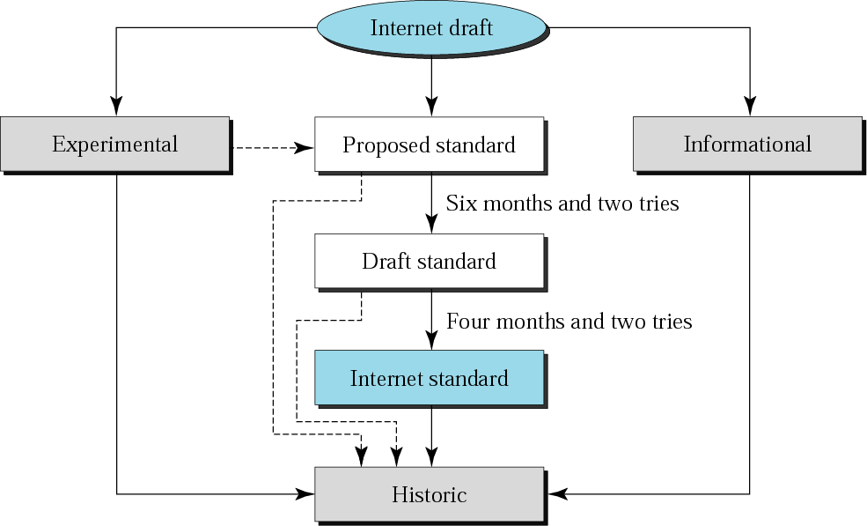
Figure 1.2 Maturity levels of an RFC

Slide 9
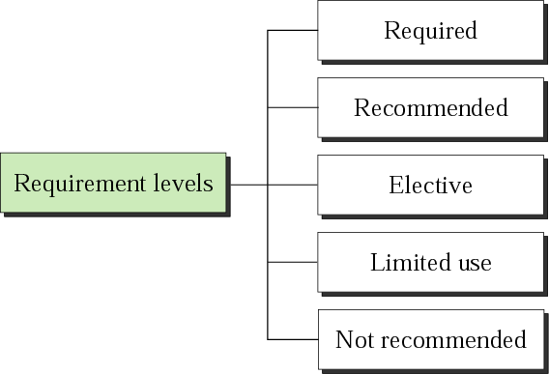
Figure 1.3 Requirement levels of an RFC

Slide 10
Note:
RFCs can be found at www.faqs.org/rfcs

Slide 11
1.5 Internet Administration
The Internet has evolved and gained a broader user base with significant commercial activity. Various groups that coordinate Internet issues have guided this growth and development.
The topics discussed in this section include:
Internet Society (ISOC)
Internet Architecture Board (IAB)
Internet Engineering Task Force (IETF)
Internet Research Task Force (IRTF)
Internet Assigned Numbers Authority (IANA)
Names and Numbers (ICANN)
Network Information Center (NIC)

Slide 12
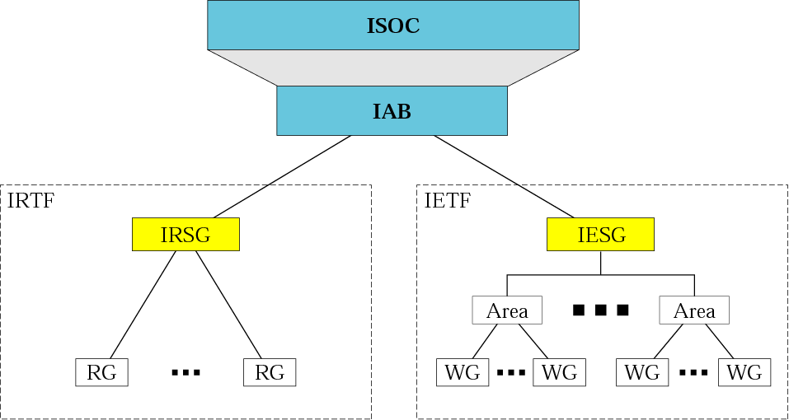
Figure 1.4 Internet administration

Slide 13
Note:
The websites for Internet organizations can be found in Appendix F.

